Slide 1
SERVSafe: Kitchen Safety

Slide 2
Electrical Appliances and Shock
Always use DRY hands to use, move or touch.
Stand on a DRY floor
Never use appliance by water or under water. Keep all cords away from water as well.
Plug the removable cords in the appliance first, THEN into the power source.
Always pull the plug, not the cord or the base
FIRST-AID In case of electrocution:
TURN OFF MAIN POWER SOURCE; that means flip the breaker- BEFORE touching the person or the appliance.

Slide 3
Knives Safety and cuts
Use a SHARP knife, it’s safer
Use a stabilized cutting board (plastic is best!)
Store knives with a safety guard/sleeve, or in in knife rack/block
NEVER throw a knife, you should always set it down for others to pick up, carry it down by you side
Clean separately
Use a damp paper towel to clean up broken glass- not a broom!
FIRST-AID for cuts:
Apply DIRECT PRESSURE over the cut, then you can run it under cool water. If you need stitches for a deep cut, make sure you get that ASAP

Slide 4
Grease Fires and burns
Keep clothing away from direct heat (that’s why tighter fitting clothes are better than loose clothing items)
Avoid paper/plastic on or near the stovetop (wood and silicone are better for less heat conduction and they are stronger)
ALWAYS use dry hot pads/oven mitts for handling hot pans/dishes
Lift lids AWAY from you (use the lid as shield)
Turn handles towards the inside or back of the stovetop
NEVER EVER EVER EVER use water to put out a kitchen fire!!!!!!! Also avoid sugar and flour.
Use the lid to smother it
Use a fire extinguisher
Use Salt, or Baking SODA
FIRST-AID for a burn: run it under cool, running water. Not too cold, not too hot, and see a doctor ASAP if it creates a blister or bubbles

Slide 6
Trips, Slips and Falls
Clean up spills as soon as they happen!
Use a step stool to reach things in high places, NEVER use anything on wheels or with an unstable surface.
Store heavy items on lower shelves.
Use non-skid, close-toed shoed with tied shoelaces or Velcro
Make sure all matts are laying flat and the floor is clear of debris

Slide 7
Cleaning supplies and Chemicals: POISONING
NEVER mix cleaning supplies
like bleach and ammonia: it creates a toxic deadly fume
Always store cleaning supplies away from food and cooking supplies like utensils and equipment
Keep cleaning chemicals in original containers, or have them labeled clearly.
FIRST-AID for Poisonings:
Have the original container handy, the amount taken, when it was taken, and call POISON CONTROL: 1-800-222-1222

Slide 8
Cleaning and sanitizing

Slide 9
Keep all work surfaces clean
Clean: removing any visible solids. This will help keep bugs away too
Disinfect/sanitize work surfaces to prevent cross-contamination
Disinfect: reduce unseen germs and bacteria with use of chemicals left on surfaces to work properly
Cross-contamination: transferring of bad bacteria from one thing to another
Clean and sanitize surfaces that are being used every 4 hours
Always use sanitizers and cleaners according to their directions
Store towels for cleaning food spills in sanitizer solution when you are not using them, never in your pockets or aprons
Use a test kit to check the strengths and ensure it’s working correctly.
To properly sanitize:
Clean the surface
Rinse the surface
Sanitize the surface
Allow the surface to air dry

Slide 10
GERMS
Stop the spreading of germs by using a clean utensil when tasting foods, and only use it ONCE.
Pathogens= microbes that cause foodborne illnesses in people.
3 types of food contaminates:
1. Biological – living organisms like fungi (mold), bacteria, viruses, etc
2. Chemical- solutions, toxic metals, pesticides. These cause poisonings, cancer, burnings.
3. Physical- broken glass, metal pieces, band-aids

Slide 11
When to wash your hands
After using the restroom
After coughing or sneezing
Before & after handling raw meat, poultry, or eggs
Before putting on gloves
After touching clothing or aprons
After handling money
After handling garbage or trash
After handling dirty equipment/utensils
Before, during AND after food preparation

Slide 12
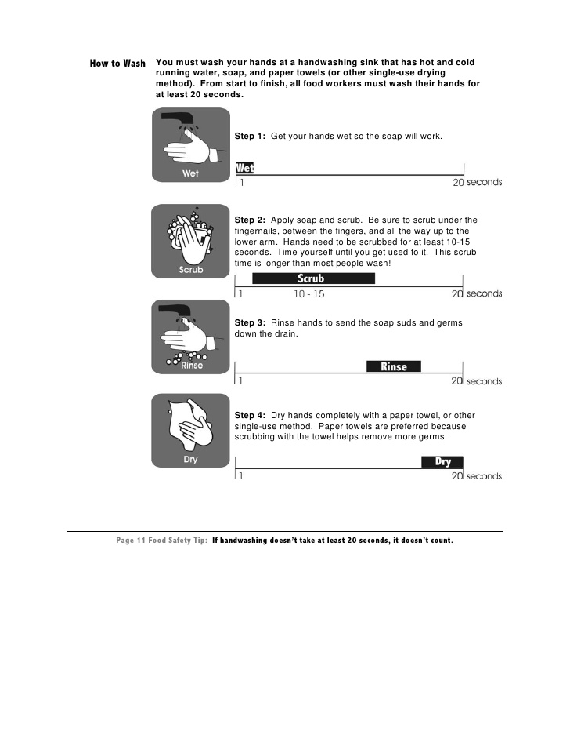
Hand Washing- 20 seconds
Wet hands and fore-arms with warm/hot water.
Apply soap
Scrub hands and arms for at least 15 seconds
Rinse hands and arms
Use an antiseptic (hand sanitizer) after washing hands
Wait for the antiseptic to dry before touching food or equipment, and before putting on gloves.
Singing the ABC’s, Twinkle-Twinkle Little Star, or Happy Birthday can help you gage your time

Slide 13
Drying hands
Dry hands and arms with paper towel
Do not use an apron, cloth towel, or clothes to dry hands (these contain bacteria)
Use the paper towel to turn off the faucet and open doors

Slide 14
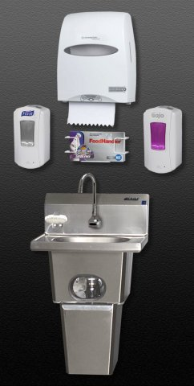
Handwashing sink
If your work place has a handwashing sink: the handwashing sink is to be used for handwashing only
Never use the designated handwashing sink for other purposes.

Slide 15
Wearing Gloves
Avoid bare-hand contact with ready to eat foods (pre-packaged)
Wear gloves if you have open sores or cuts on our hands
A bandage must cover the wound completely and a glove must be worn over the bandage.
Use the correct size glove so they fit and do not rip or get stuck.
Never rinse, wash or reuse gloves.
Wash hands before putting on gloves and when changing to a new pair.
Change gloves with each new task.

Slide 16
Clothing, Hair and Jewelry
Wear a CLEAN apron and clothing to prevent spreading of germs
Tie hair back or cover hair
Remove all jewelry from hands and arms, including rings, bracelets and watches.
The ONLY exception is a plain band ring

Slide 17
Dishwashing – by hand
Wash dishes in the following order:
Rinse and Scrape Food
Glassware
Silverware
Dishware (plates, bowls)
Kitchen tools
Pots and Pans

Slide 18
Dish Washing- 3 sink method

Slide 19
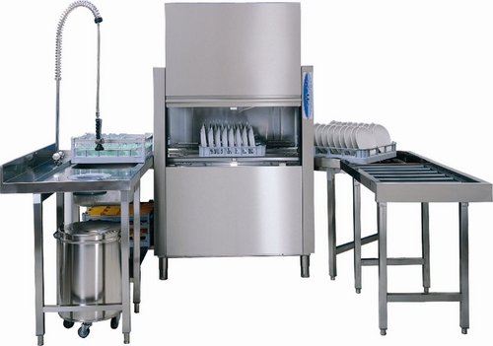
Dish Washing-- Dish Machine
Dish Machines are used in the industry to quickly clean and sanitize dishes
Scrape, rinse or soak items before washing.
Never overload the dish racks and use the correct racks
Frequently check water temperature and pressure
Change the water when necessary

Slide 20
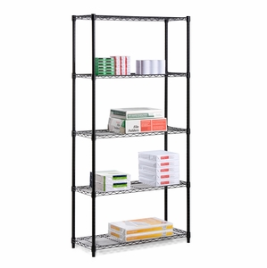
Storing Dishes and Utensils
Store in a clean, dry location
Store at least 6-inches above the floor
Store upside down on a clean, sanitized surface.
If storing utensils vertically, store them with handles up.

Slide 21
Trash and Garbage
Remove the garbage from prep area as quickly as possible.
Do not clean garbage containers in or near food prep areas.
Use trashcan liners.
Clean the inside and outside of garbage containers often.
Close the lids on outdoor containers.

