Slide 1
Food Prep
AND STORAGE

Slide 2
WHEN Preparing to cook:
Clean (remove solids) and Disinfect work surfaces (spray with cleaner)
Tie hair back- safety and sanitation issues
Put on an apron- to keep you clean and your clothes from catching on fire
Wash your hands for 20 seconds
Put on gloves if you have a cut/open wound, or if you will be handling any ready to eat foods (meats, salads, cheeses, etc)

Slide 3
Important guidelines:
Mise-en-place- French for “put into place.”
  Chipotle Culinary Video
#1 Rule from Top Chefs:
Read the recipe all the way through

Slide 4
3 different recipe formats
Standard: ingredients listed first, then instructions follow.
Action: pictures to refer to throughout the recipe.
Narrative: recipe in paragraph form with no organization.

Slide 5
When cutting a recipe in half, or when doubling a recipe:
The cooking TEMPERATURE remains the same, but the SIZE of the cooking pan and the length of TIME may be affected.
When baking with a glass dish, you need to reduce (lower) the oven temperature by: 25⁰

Slide 6
Thawing foods
SAFEST WAY = Fridge for multiple days if needed.
Microwave, if using immediately
Cool running water
As part of the cooking process
NEVER on the counter

Slide 7
Fridge storage
Set fridge temps to 41 degrees or lower
Fridges and freezers need to circulate air to work properly (this means don’t overload them)
  All foods, especially raw meats should be sealed and wrapped to prevent cross contamination
  Store raw meats separately if possible, if not, always store on them below other prepared foods (lowest shelf or drawer possible)

Slide 8

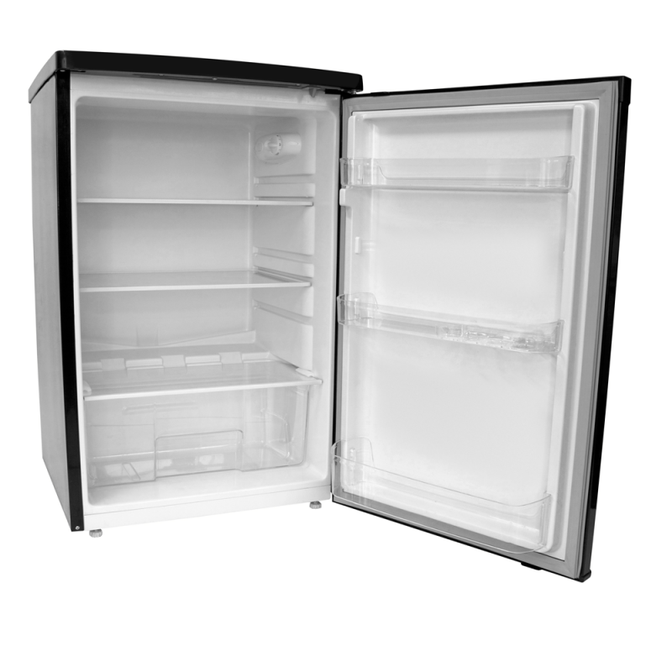
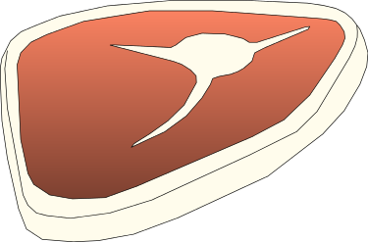
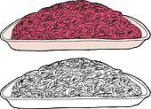
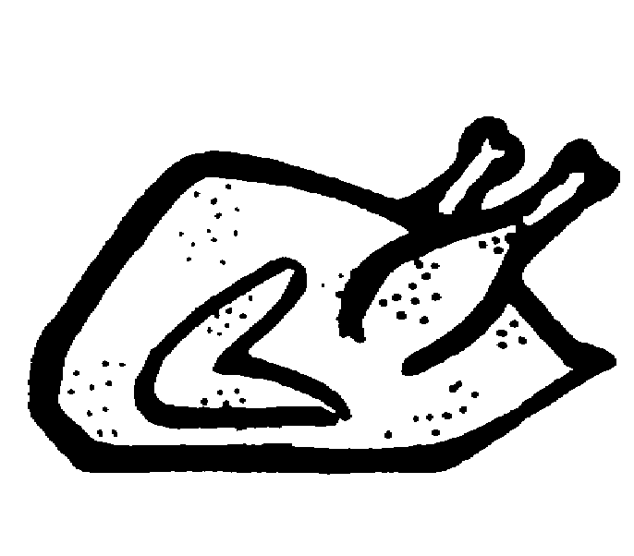
Proper Meat Storage
Whole fish
Whole cuts of beef and pork
Ground meats
All poultry

Slide 9
Storing foods
Left overs should not be stored for more than 5 days
If foods are removed from their original container they should be stored in a sealed container with a proper fitting lid, then labeled with the name and original use by date on it.
F.I.F.O= First In First Out
  This is a rotational storage practice, using the earliest use-by-date first
  Chipotle video
When if doubt, throw it out!

Slide 10
Cooling foods
When cooling foods you should cut large foods into smaller portions and store them in shallow containers so that foods cool more quickly.
You can also use an ice bath to cool items quickly. This reduces the time in the danger zone
Keep hot foods hot and cold foods cold
Foods should not be in the danger zone (sitting out) for more than 2 hours, refrigerate or freeze as soon as possible.

Slide 11
Bacterial Growth
F- food
A- acid
T- Temperature
T- Time
O- Oxygen
M- Moisture

Slide 12
Cross Contamination
The transferring of harmful bacteria's from one food to another

Slide 13
Foodborne illness
Salmonella- comes from chicken and eggs
Staph- comes from your best friend’s mucus and pre-packaged foods
E-coli- found in products from cows. Preventable by cooking foods thoroughly
Hepatitis A- found in feces (poop). Easily prevented by washing hands
Botulism- Most deadly. Attacks the nervous system. From improperly canned foods that are low in acid

Slide 14
Review the temperatures and equivalents on your own

